Slide 1
Graduation Project.
Computer Vision Verification of Sample Self-Acquisition for Self Diagnostics Using Deep Learning

Slide 2
Under Supervision of Prof. Dr. Mahmoud Ibrahim Khalil
By
Ahmed Sameh Shahin 16P6063
Karim Walid Abdelazim 16P3090
Moataz Khaled Zakaria 16P8244
Mohammed Ehab Elsaeed 16P8160

Slide 3
—Dr. Michael J. Ryan, WHO Informal Advisory Group
“Epidemics are a stress test for a system....the issue is how much resilience is built into those systems. Our hospital systems are designed to deliver at 99% efficiency. There's no space for them to deliver anymore..”

Slide 4
01.
Introduction

Slide 5


Self-Testing Attempts

Slide 6
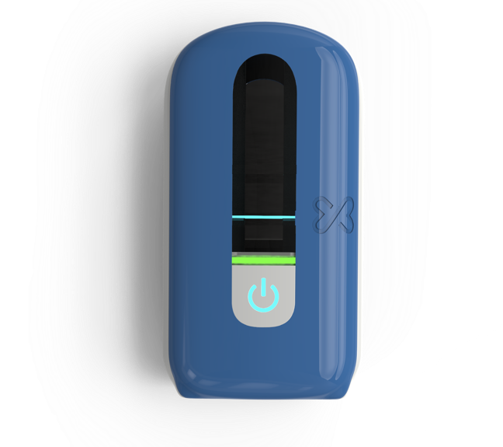
Xtrava’s Microlab Platform

Slide 7
02.
Problem in Hand

Slide 8
Problem Statement
An application to verify that a user inserted the swab in both the right and left nostrils without the need for a medical professional. This involves multiple sub problems to solve, mainly detection and localization of swabs, detection and localization of facial key points, and detection of Aruco markers’ ID’s and orientation.

Slide 9
Scope
Benefits:
Reduced costs
Lower loads on hospitals and clinics
Accuracy
Ease-of-use
Minimization of errors in sample collection and preparation
Self-testing.
Objectives:
Detect users’ movements.
Detect test tools (swab)
Monitor users’ actions while performing the test.
Goals:
Validate and verify that users follow the given steps during self-testing.

Slide 10
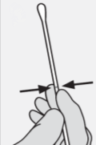
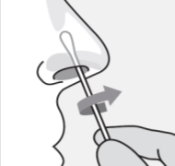
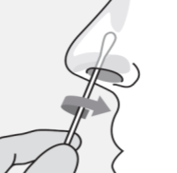
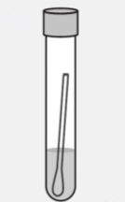
Sample Collection
1
2
3
4
Get the swab out avoiding touching its tip
Collect Sample from right nostril using turning motion
Collect Sample from left nostril using turning motion
Put the swab in provided solution

Slide 11

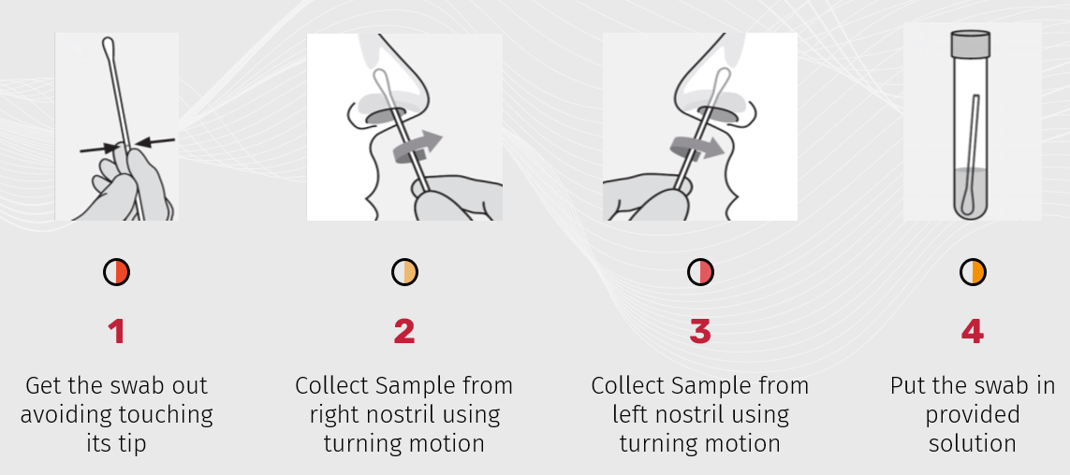
Intended Use
Verifying the steps needed to accurately perform the covid-19 test at home using the MicroLab testing kit

Slide 12
Functional Requirements
Detect and localize swabs in an image frame.
Detect Visual markers
Detecting facial key points for the nose
Detecting Insertion of swab in right and left nostrils by using the output of the past 3 features.

Slide 13
Non-Functional Requirements
Realtime, up to 1s delay in response.
User-friendly interface.
Reliable.

Slide 14
Assumptions and Dependencies
Dependencies:
Android firmware
Camera’s resolution
Camera angles
Lighting
Exposure
Camera’s line of sight.
Assumptions:
User acknowledges the given steps.
User using tools marked with the Visual markers.

Slide 15
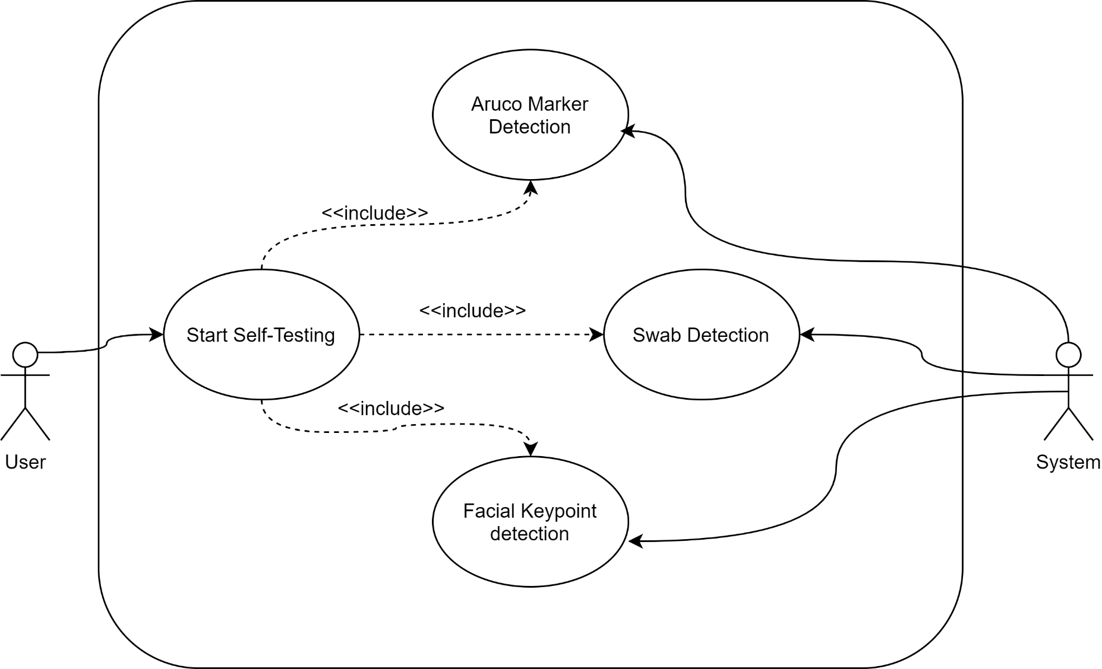
Use Case Diagram

Slide 16
Primary Analysis
Upon primary analysis, these subproblems were observed:
Facial Key point Detection
Swab Detection
Need for a visual marker and Its detection

Slide 17
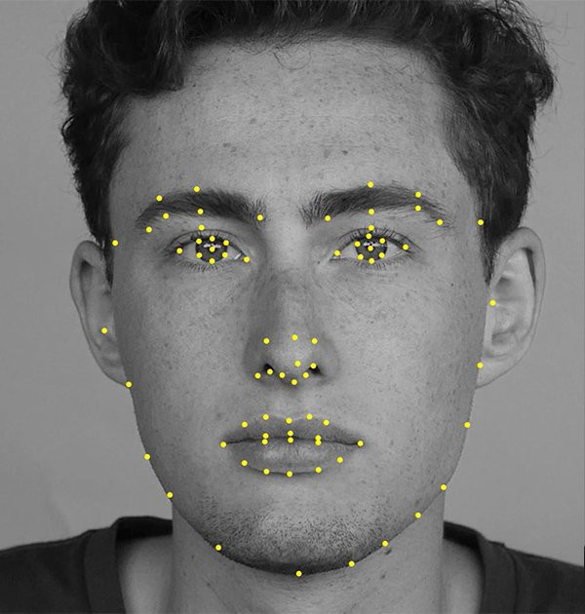
Facial Keypoint Detection

Slide 18
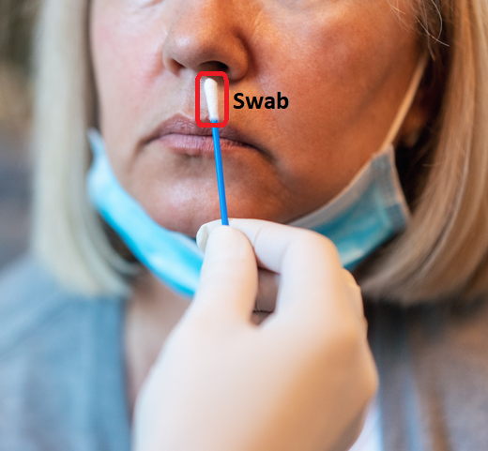
Swab Detection

Slide 19
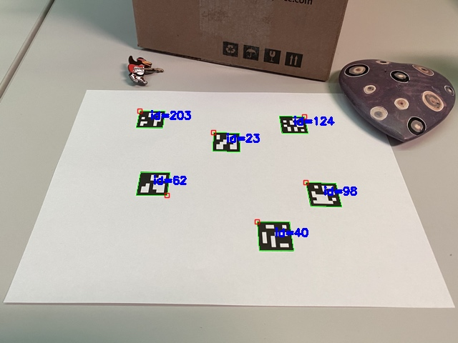
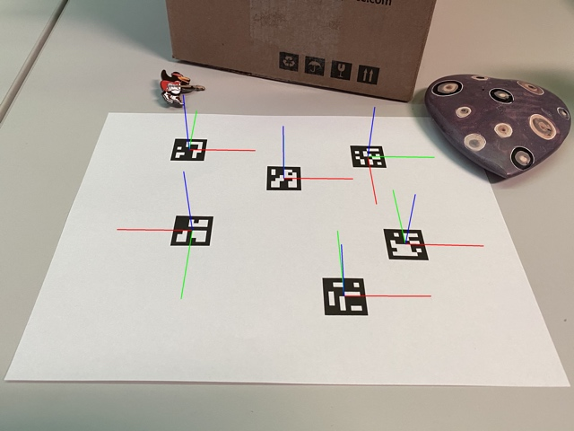
Visual Marker Detection

Slide 20
03.
Prospective Solutions

Slide 21
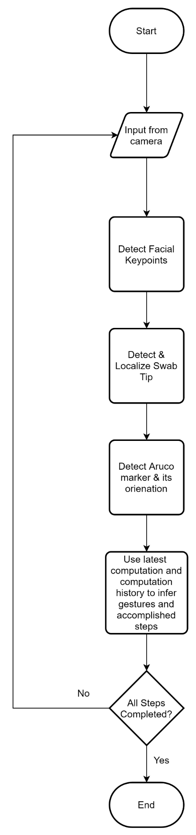
Solution Architecture

Slide 22
FACIAL KEY POINT DETECTION
CNNs
Several CNN architectures have been effective in facial key point detection, one of the proposed architectures is NaimishNet

Slide 23
SWAB DETECTION
YOLO
SSD
You Only Look Once
Single Shot Detector
State of the art single-stage object detection architectures are YOLO and SSD. We are considering only single-stage architectures due to our need of real-time performance. SSD uses multi-scale convolutional feature maps at the top of the network instead of fully connected layers as YOLO

Slide 24

VISUAL MARKER DETECTION
OPEN CV
The OpenCV Library has built-in support for ArUco markers detection and generation.

Slide 25
Conclusions
Summarizing the presentations most important points.

Slide 26
Thank You! Any Questions?

